Slide 1

Hadoop
Meryem Yahya

Slide 2

Plan
Installation
Upload files to HDFS
MapReduce
Command
Results

Slide 3

Installation

Slide 4
Environment
Hadoop 3.3.1
Ubuntu18
Java 8
Notes:
Install jdk8

Slide 5
Hadoop folder
hadoop
hadoop-3.3.1
hadoopData
hdfs
datanode
namenode
Notes:
Download hadoop and extract zip
Hadoop-3.3.1 folder contains extracted zip file
hadoopData folder for hdfs data

Slide 6
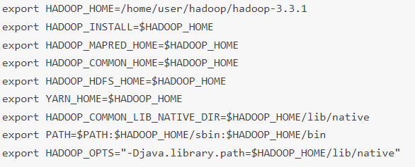
Variable path
Notes:
Add environment variable path
Add this lines to .bashrc
Hadoop home = hadoop location files

Slide 7
Config files
hadoop-env.sh
core-site.xml
hdfs-site.xml
mapred-site-xml
yarn-site.xml
Notes:
Change the following config files with the following configs

Slide 8
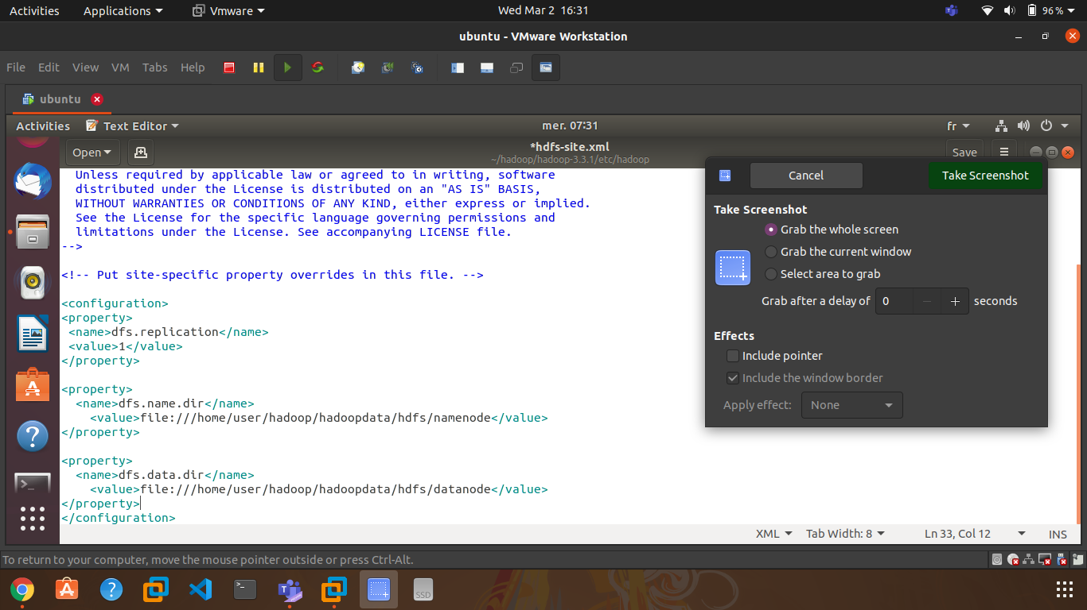
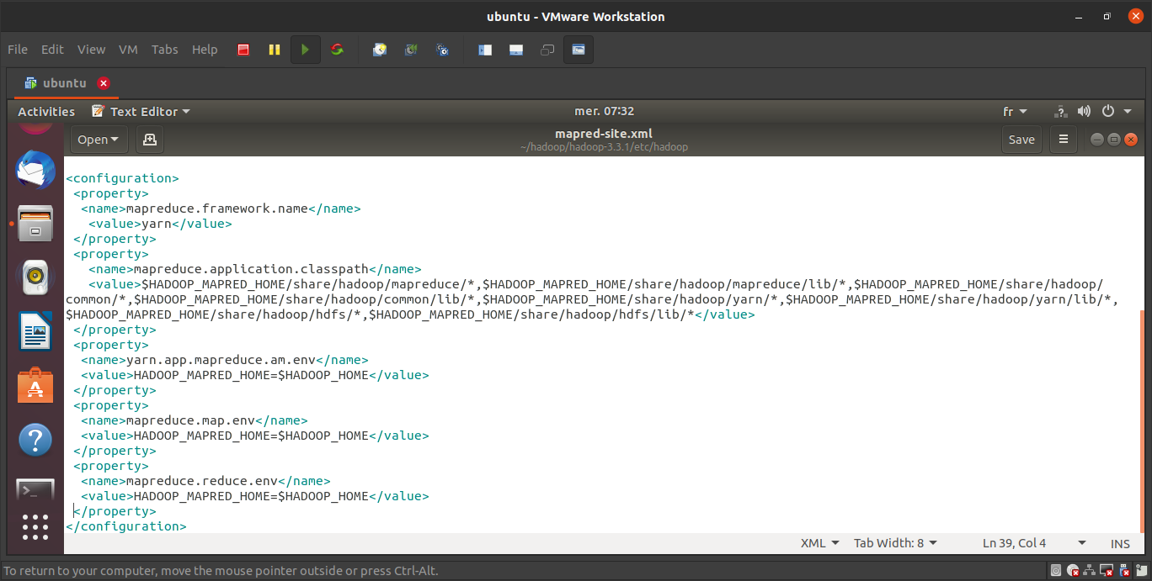
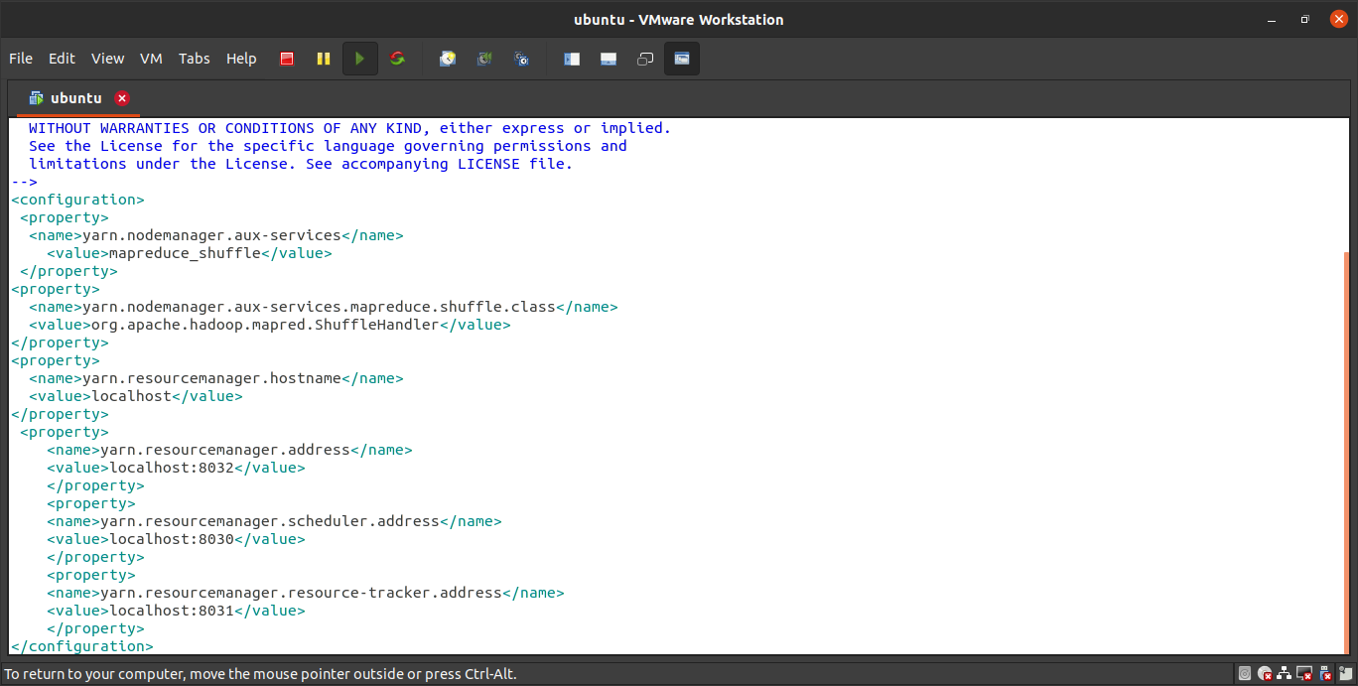
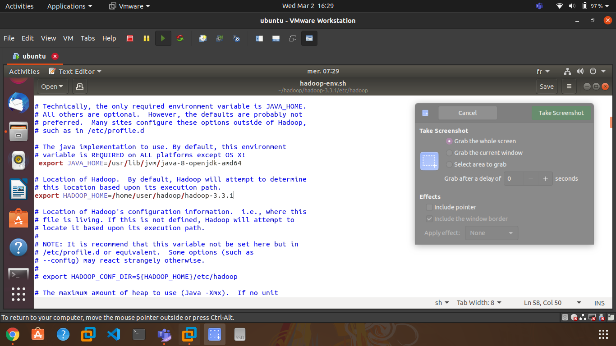
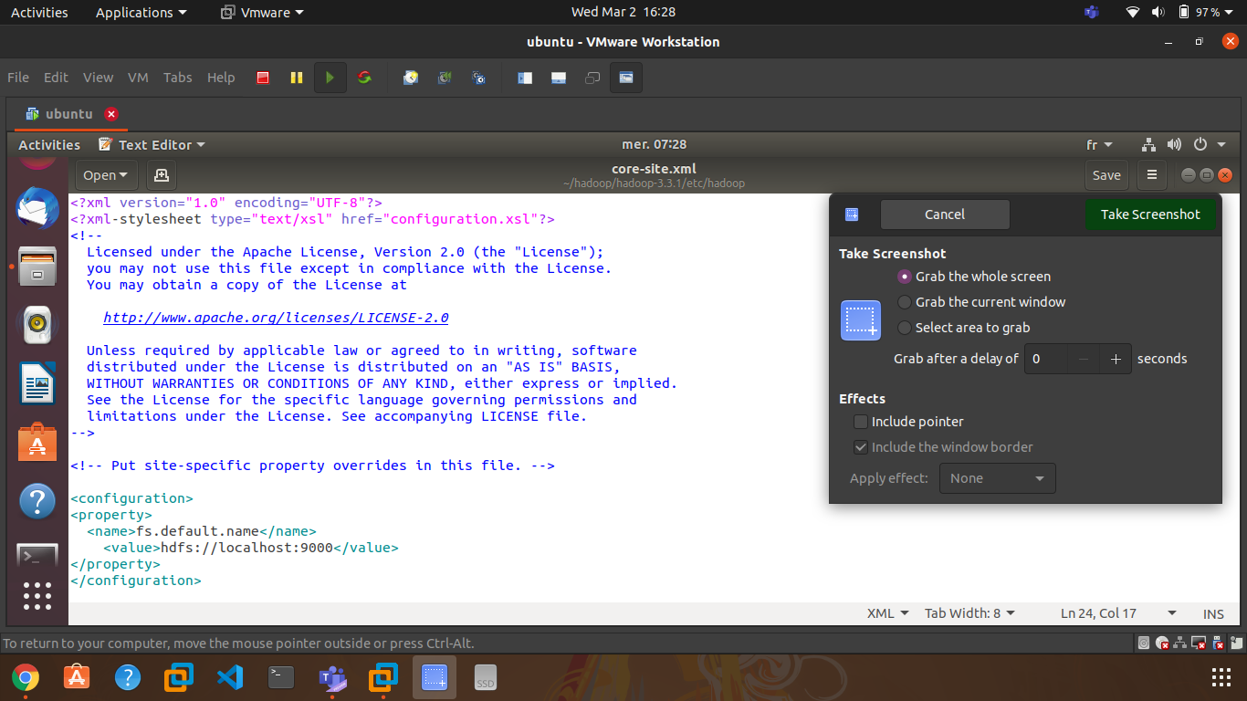
mapred-site-xml
hdfs-site.xml
yarn-site.xml
hadoop-env.sh
core-site.xml
Notes:
Config files after edit

Slide 9
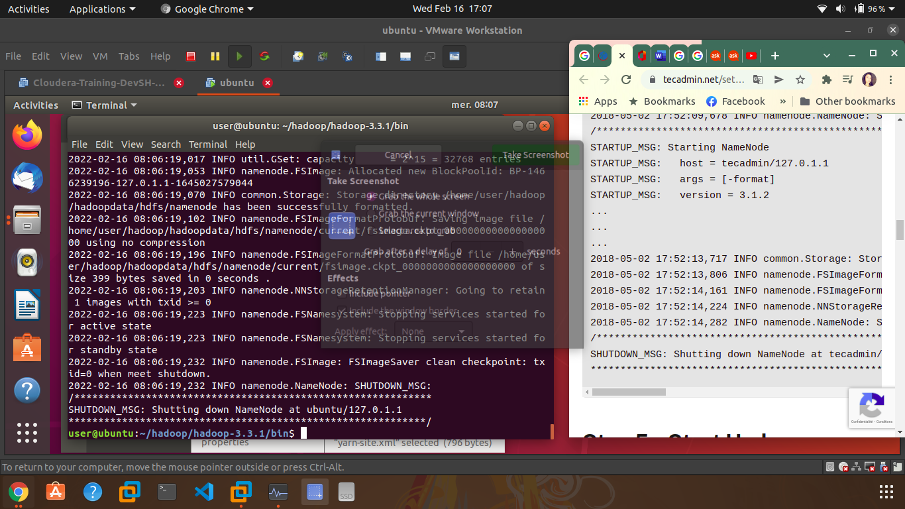
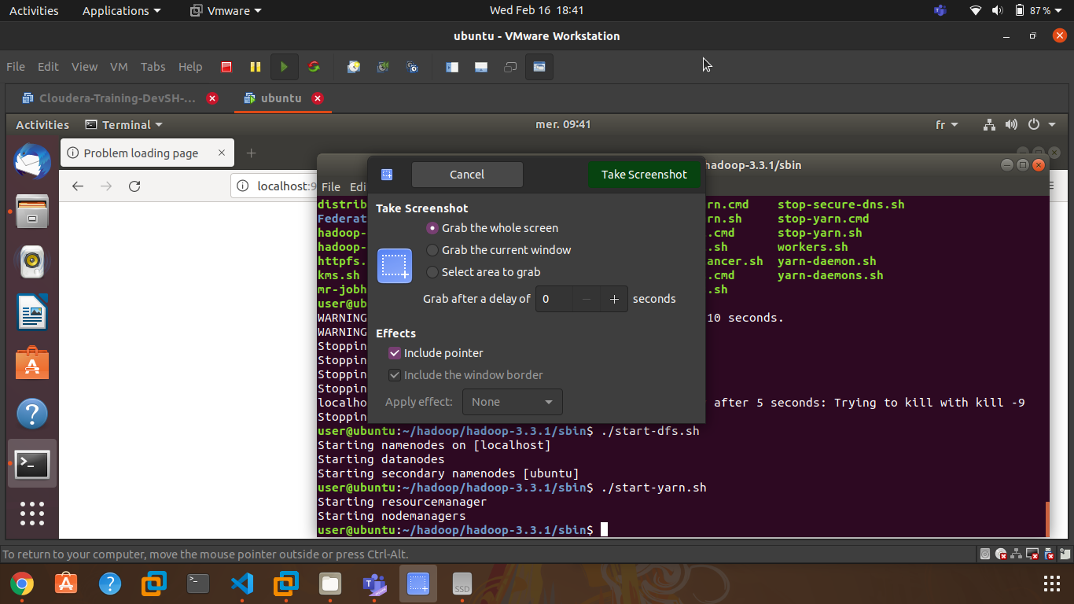
Format node & Start nodes and managers
Notes:
Execute the command format node
Execute scripts ./start-dfs.sh and ./start-yarn.sh to start nodes and managers

Slide 10
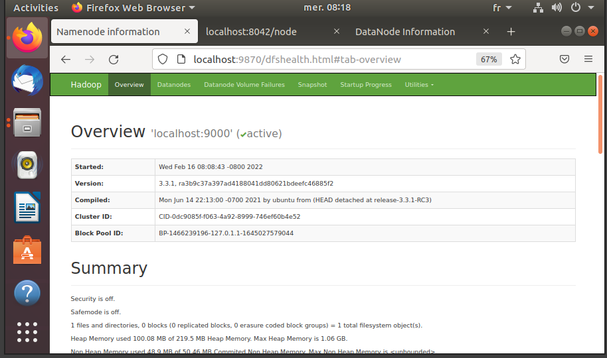
Notes:
Result in browser http://localhost:9870

Slide 11

Upload files to HDFS

Slide 12
HDFS directory structure
/data
/tripdata
/yellow
/green
/2019
/2020
/2021
CSV files
CSV files
CSV files
/2019
CSV files
/2020
CSV files
/2021
CSV files
/output
Notes:
Create directory : hdfs dfs –mkdir /dir_name
Upload folder : hdfs dfs -copyFromLocal /folderpath /to_hdfs_path
Upload folder content : hdfs dfs -copyFromLocal /folderpath/* /to_hdfs_path

Slide 13
Block size / input split size
Not same order/name column
Bigger CSV files size
Mapper per file
Notes:
Yellow and green data CSV don't have same order and names column we should use header to access column, but csv are divided to blocks (128mb by default) when created in HDFS and before being passed to mapper so to execute one MapReduce process we should force one mapper per csv file by increasing min block size while importing to HDFS and input split size passed to mapper in MapReduce job , block size and input split size will equal to the bigger CSV file’s size
-D dfs.blocksize=762314752b 727mb
mapreduce.input.fileinputformat.split.minsize=276824064 264mb

Slide 14
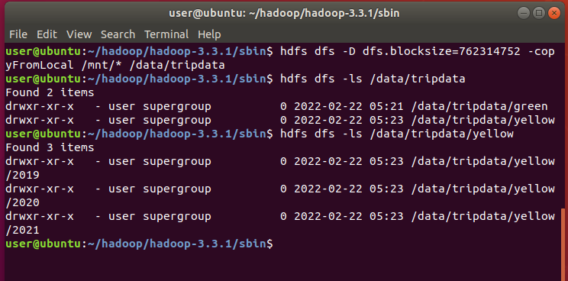
Notes:
CSV import

Slide 15
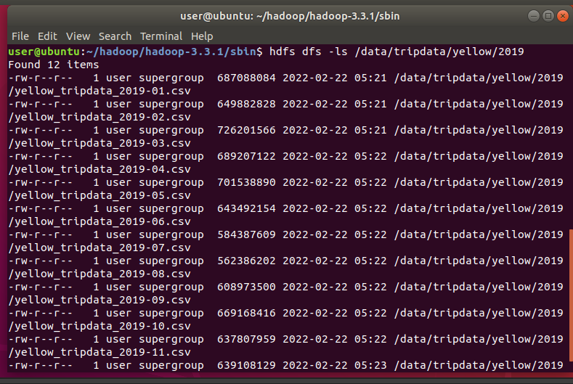

Slide 16


MapReduce

Slide 17

Preferred payment type

Slide 18
Payment type
#1 Credit card
#2 Cash
#3 No charge
#4 Dispute
#5 Unknown
#6 Voided trip
Notes:
Payment type and corresponding number ID

Slide 19
Preferred payment type Mapreducer
map
1 1
2 1
Shuffle & sort
1 1
output
Credit card total_count
1 1
4 1
1 1
2 1
4 1
Cash total_count
No charge total_count
Dispute total_count
Unknown total_count
Voided trip total_count
Preferred = max (total count)
Reduce
1 2
Max(count)
Preferred Payment type == max
2 1
4 1
Count payment type occurrence
(payement type , 1)
(payement type , 1)
Notes:
Mapper will output (payment_type , 1) each time reading a line
Sort and shuffle mapper outputs
Reducer will count the occurrence for each payment type print result then select the max count and output the payment type with the max count

Slide 20
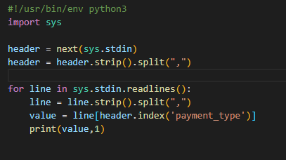
mapper

Slide 21
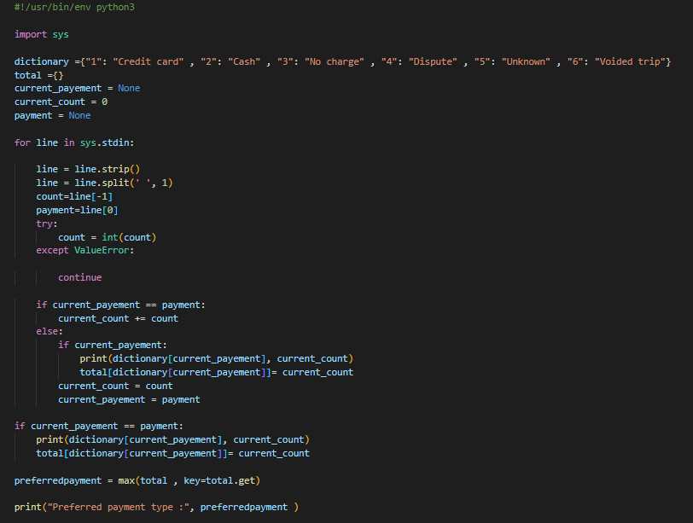
reducer

Slide 22
Command
preferred payment type of the green taxis
preferred payment type of the yellow taxis
hadoop jar /home/user/hadoop/hadoop-3.3.1/share/hadoop/tools/lib/hadoop-streaming-3.3.1.jar
-file /mnt/scripts/mapper.py
-mapper /mnt/scripts/mapper.py
-file /mnt/scripts/reducer.py
-reducer /mnt/scripts/reducer.py
-input /data/tripdata/green/*
-output /output/2b-output
hadoop jar /home/user/hadoop/hadoop-3.3.1/share/hadoop/tools/lib/hadoop-streaming-3.3.1.jar
-file /mnt/scripts/mapper.py
-mapper /mnt/scripts/mapper.py
-file /mnt/scripts/reducer.py
-reducer /mnt/scripts/reducer.py
-input /data/tripdata/yellow/*
-output /output/2a-output

Slide 23
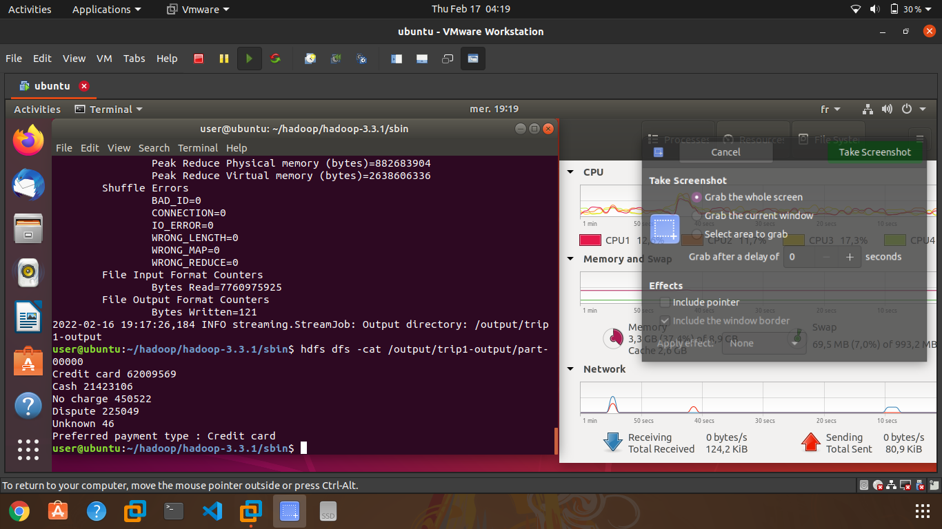
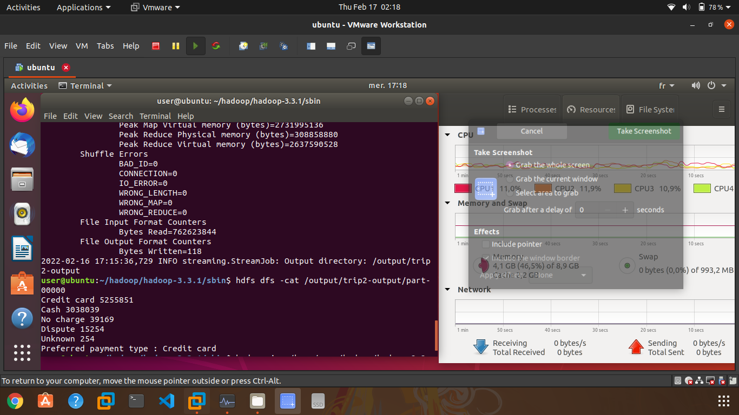
Yellow taxis
Green taxis

Slide 24

Average trip distance per year

Slide 25
Average trip distance per year Mapreducer
map
2019 3,2
Shuffle & sort
2019 3,2
Output
Reduce
2018 4,2
2019 1,5
2020 3,0
2018 4,2
2019 1,5
2020 3,0
Count (year occurrence)
Year avg_distance mi
sum( distance for each year)
Avg = sum / count
(year, trip duration en mile)
Notes:
The mapper will output ( year , trip distance in mile)
Sort and shuffle mapper outputs
Reducer will for each year count occurrence , sum distances and calculate the average then output the result

Slide 26
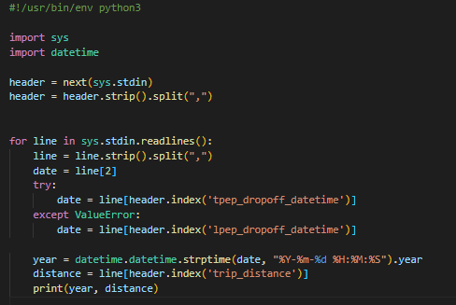
mapper

Slide 27
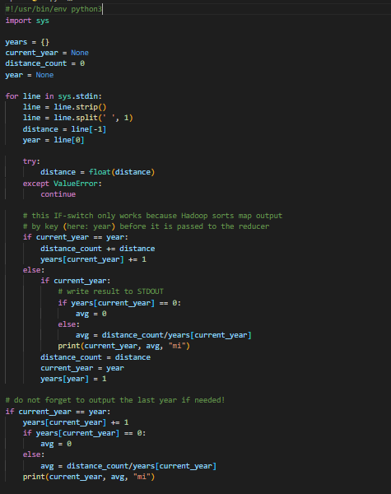
reducer

Slide 28
Command
hadoop jar /home/user/hadoop/hadoop-3.3.1/share/hadoop/tools/lib/hadoop-streaming-3.3.1.jar
-D mapreduce.input.fileinputformat.split.minsize=276824064
-file /mnt/scripts/mapper.py
-mapper /mnt/scripts/mapper.py
-file /mnt/scripts/reducer.py
-reducer /mnt/scripts/reducer.py
-input /data/tripdata/*/2021
-output /output/2c-output
Notes:
-D mapreduce.input.fileinputformat.split.minsize=276824064 this argument to force csv files don’t be split until they reach 264mb so a mapper will get a complete csv
264mb the size of the bigger file

Slide 29
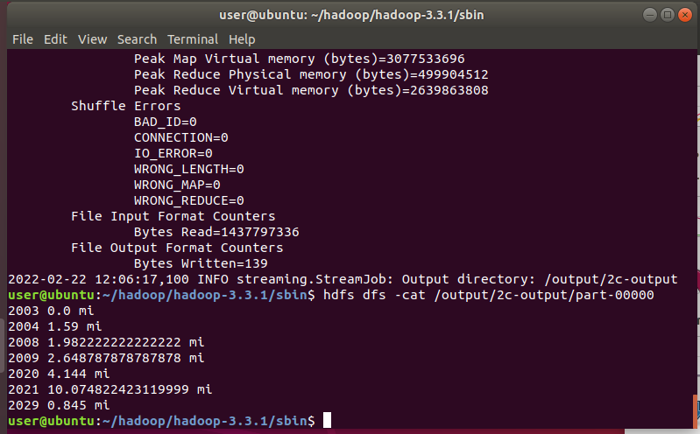
Notes:
Distances in miles

Slide 30

Average trip duration by destination

Slide 31
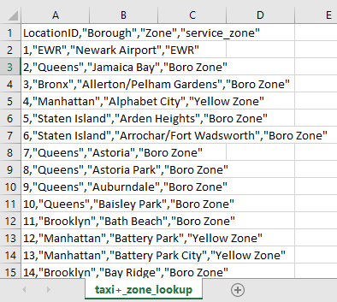
Taxi Zone Maps and Lookup Tables
Notes:
This CSV file contains region name id and other informations

Slide 32
Average trip duration by destination Mapreducer
map
10 2,10
20 3,5
Shuffle & sort
10 2,10
output
Destination_ID Destination_Name avg_datetime
80 6,9
45 7,8
Reduce
Avg = sum /count
Count destination occurrence
Sum(duration per destination)
20 3,5
80 6,9
45 7,8
Read taxi_zone_map file and create dictionary
(Destination_ID , duration sec)
(Destination_ID , duration sec)
Notes:
Map will output (destination id , duration in second)
Sort and Shuffle
Reduce will read taxi_zone_map file and create dictionary from , Count destination occurrence , Sum duration and calculate average for each destination, then output for each destination the id name and average duration in datetime type

Slide 33
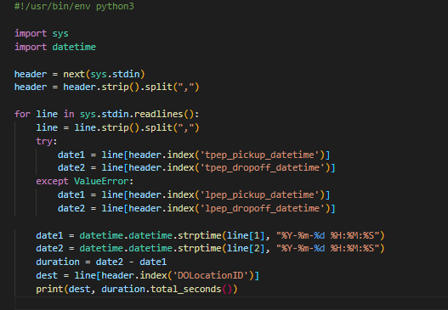
mapper

Slide 34
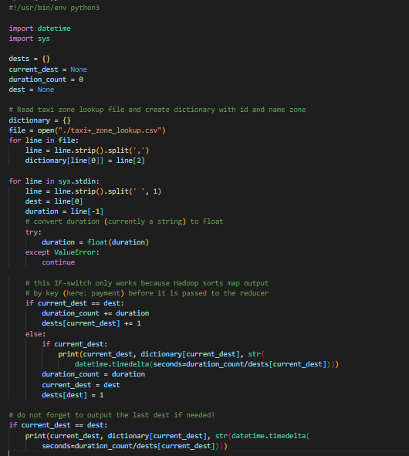
reducer

Slide 35
Command
hadoop jar /home/user/hadoop/hadoop-3.3.1/share/hadoop/tools/lib/hadoop-streaming-3.3.1.jar
-D mapreduce.input.fileinputformat.split.minsize=276824064
-file /mnt/scripts/mapper.py
-mapper /mnt/scripts/mapper.py
-file /mnt/scripts/reducer.py
-reducer /mnt/scripts/reducer.py
-file /home/user/scripts/taxi+_zone_lookup.csv
-input /data/tripdata/*/2021
-output /output/2d-output
Notes:
-D mapreduce.input.fileinputformat.split.minsize=276824064 this argument to force csv files don’t be split until they reach 264mb so a mapper will get a complete csv
264mb the size of the bigger file

Slide 36
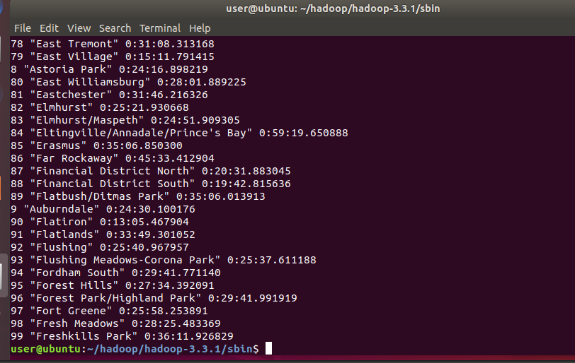

Slide 37
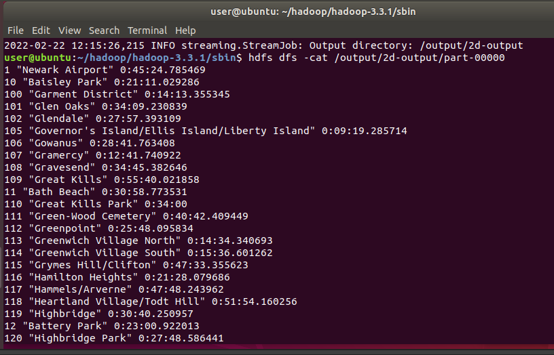

Slide 38

Average tip amount

Slide 39
Average tip amount Mapreducer
map
1,3 1
2,5 1
Shuffle & sort
1,3 1
output
Avg_tip_amount
1,0 1
4,5 1
Reduce
Count all occurrence
2,5 1
1,0 1
4,5 1
Sum(tip amount)
Avg = sum /count
(tip_amount, 1)
(tip_amount, 1)
Notes:
Mapper will output (tip amount , 1)
Shuffle and sort
Reducer will count all occurrence or total lines , sum tips amount and calculate average then output result

Slide 40
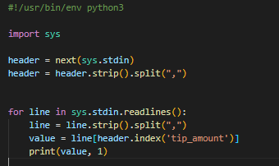
mapper

Slide 41
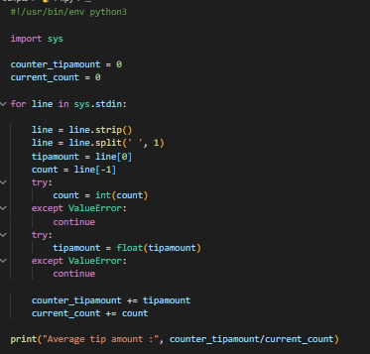
reducer

Slide 42
Command
hadoop jar /home/user/hadoop/hadoop-3.3.1/share/hadoop/tools/lib/hadoop-streaming-3.3.1.jar
-D mapreduce.input.fileinputformat.split.minsize=276824064
-file /mnt/scripts/mapper.py
-mapper /mnt/scripts/mapper.py
-file /mnt/scripts/reducer.py
-reducer /mnt/scripts/reducer.py
-input /data/tripdata/*/2021
-output /output/2e-output
Notes:
-D mapreduce.input.fileinputformat.split.minsize=276824064 this argument to force csv files don’t be split until they reach 264mb so a mapper will get a complete csv
264mb the size of the bigger file

Slide 43
